Slide 1
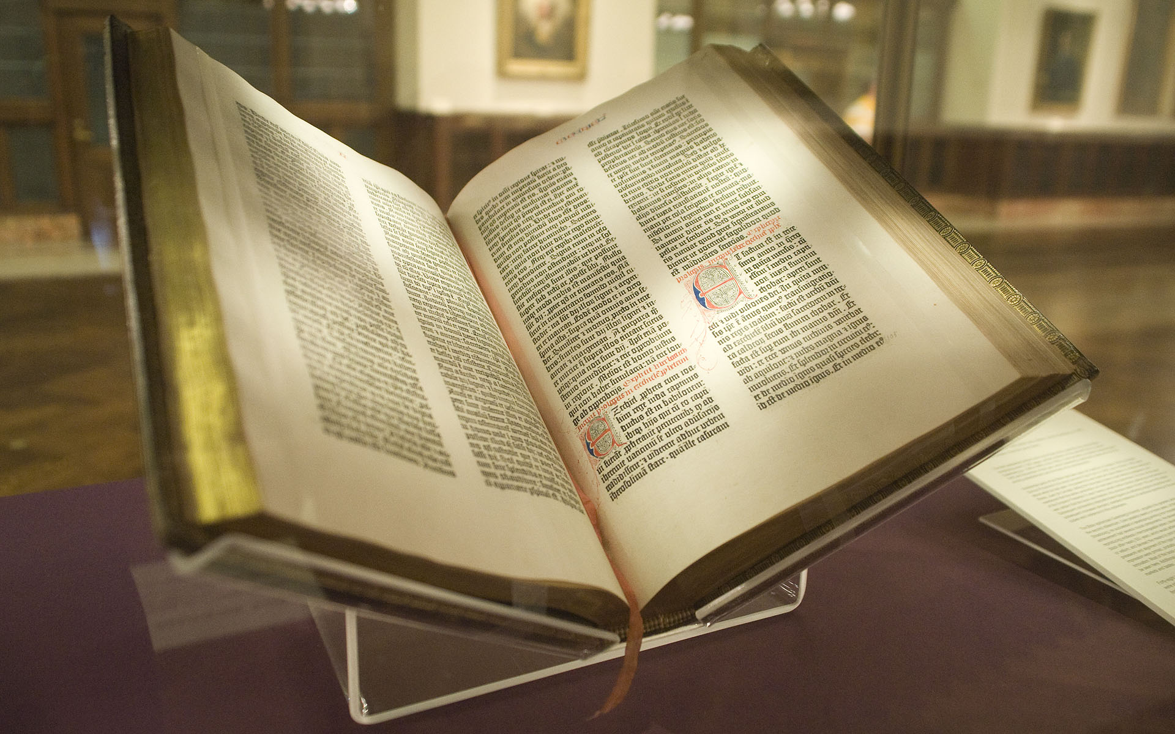
Datum: _________ Nr.: _____
Erstes
Testament
_____________________________________________________________________________________________________________________________________________________________________________________________
_______________________________________________________________
Gen 12,10-20
_____________________________________________________________________________________________________________________________________________________________________________________________
_______________________________________________________________
_____________________________________________________________________________________________________________________________________________________________________________________________
Ex
20,16
Dtn
19,16-21
Zweites Testament
Mt
26,34
_____________________________________________________________________________________________________________________________________________________________________________________________
_______________________________________________________________
_______________________________________________________________
Mt
26,69-75
Joh
8, 44
_____________________________________________________________________________________________________________________________________________________________________________________________
_______________________________________________________________
_______________________________________________________________
Eph
4,25-32
Arbeitsaufträge:
Schlage die entsprechenden Stellen in der Einheitsübersetzung oder im Internet nach.
Beschreibe in deinen eigenen Worten, wie „die Lüge“ in der Textpassage behandelt wird und in welchem Zusammenhang (Kontext) das Theam steht.
https://kurzelinks.de/DFG-Bibel-Luege
Abb.: NYC Wanderer (Kevin Eng), 2009, File:Gutenberg Bible, Lenox Copy, New York Public Library, 2009. Pic 01.jpg, CC BY-SA 2., http://kurzelinks.de/CC-BY-SA-20-Generic, https://commons.wikimedia.org/wiki/File:Gutenberg_Bible,_Lenox_Copy,_New_York_Public_Library,_2009._Pic_01.jpg | (Zugriff: 18.03.2024)

